Slide 1



Home Security Robot

Slide 2
Problems
01
Complexity of installation of a security system
02
CCTVs can have blind spots
03
Lack of intelligent monitoring in security systems
04
Slow response time and human errors
02
Sahan W A G – IT22360250

Slide 3
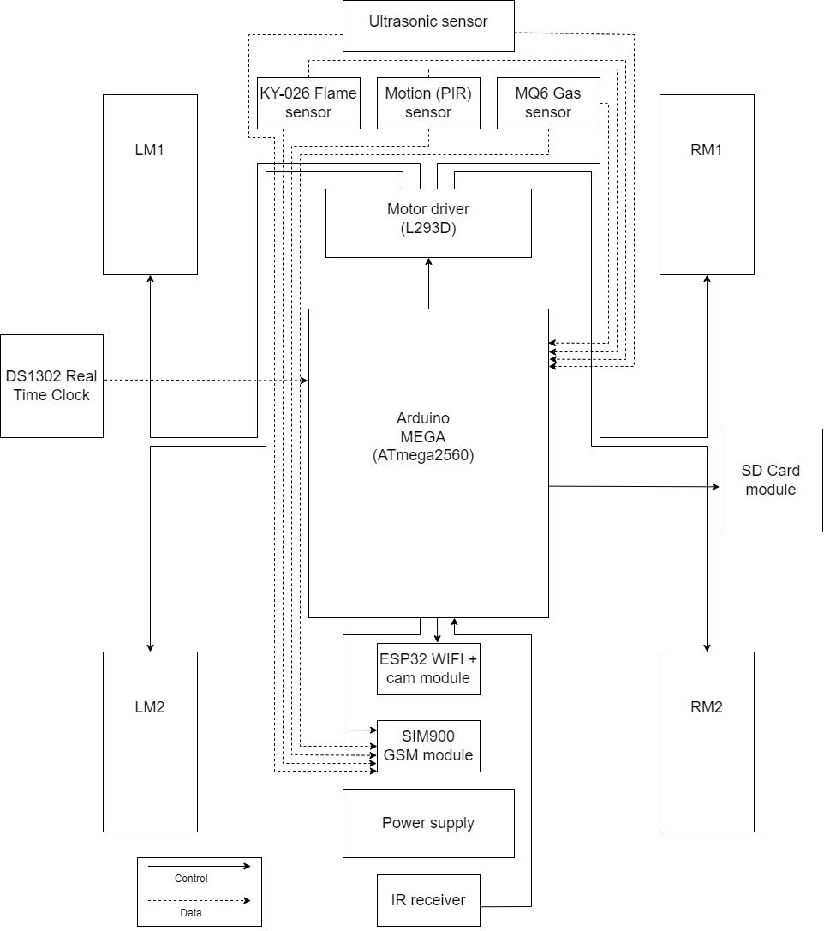








Solution
High Level Architecture Diagram
Co2
03
Sahan W A G – IT22360250

Slide 4

Key benefits
01
02
03
04
Easy to install
Mobility and Scalability
Data collection and analysis
Comprehensive detection skill
User need minimal technical knowledge to install cypher.
Ready for deployment immediately after installation.
The mobility of Cypher reduces blind spots.
Scalable design ensures that the Cypher can grow alongside the user’s security needs.
Cypher’s advanced sensors and intelligence enable efficient collection and analysis of security data, enhancing proactive threat detection.
With its advanced technology, Cypher offers capabilities such as motion detection, fire identification, and gas leak detection
04
Sahan W A G – IT22360250

Slide 5
Objectives
To build a surveillance robot that utilizes sophisticated sensor technology to detect human motion, fire, and gas, promptly alerting the user for a swift response, thus enhancing security measures and ensuring effective threat detection in various environments.
Sub - Objectives
Developing the software algorithms for detecting human motion, fire, and gas.
Integrating the hardware and software components to create a functional surveillance system.
Testing and validating the system to ensure the robot functions accurately.
Optimizing the system for affordability, reliability, and ease of use.
05
N.W.A.R.S. Karunarathna – IT22069368

Slide 6

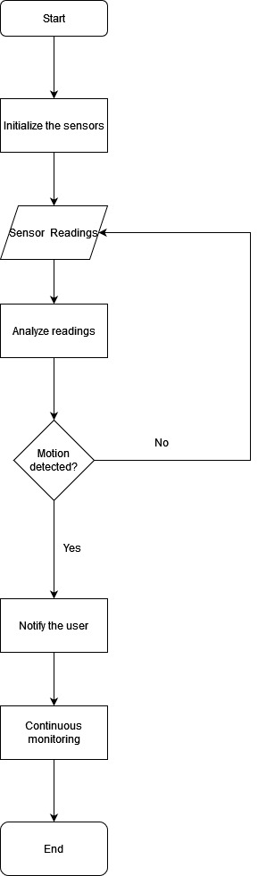
Methodology
If a PIR sensor detects changes in infrared radiation caused by an intruder (human), GSM module sends a notification to user
06
N.W.A.R.S. Karunarathna – IT22069368

Slide 7
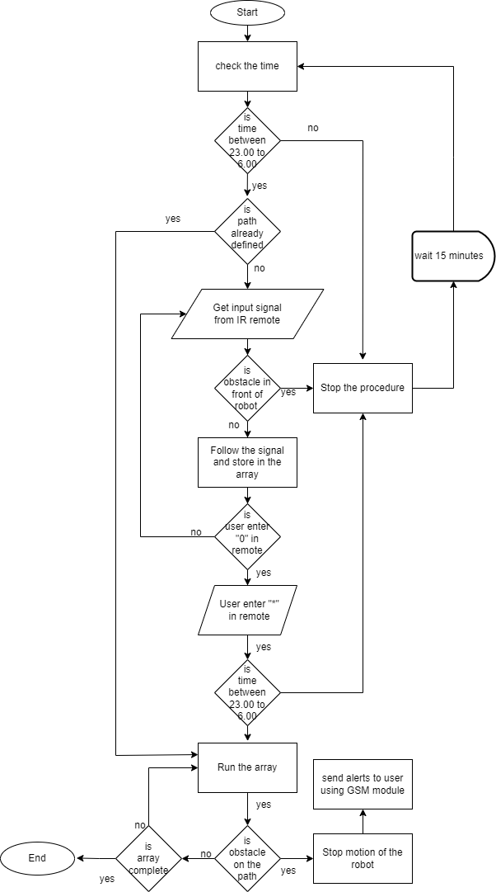
User manually inputs the path of the robot using IR remote
The robot store the path in Arduino board’s EEPROM
If the time is between 11 PM and 6 AM, the robot follows the path stored in the EEPROM
If there is any obstacle in the predefined route, robot stop its movement and sends a notification to user using the GSM module
07
Sahan W A G – IT22360250

Slide 8
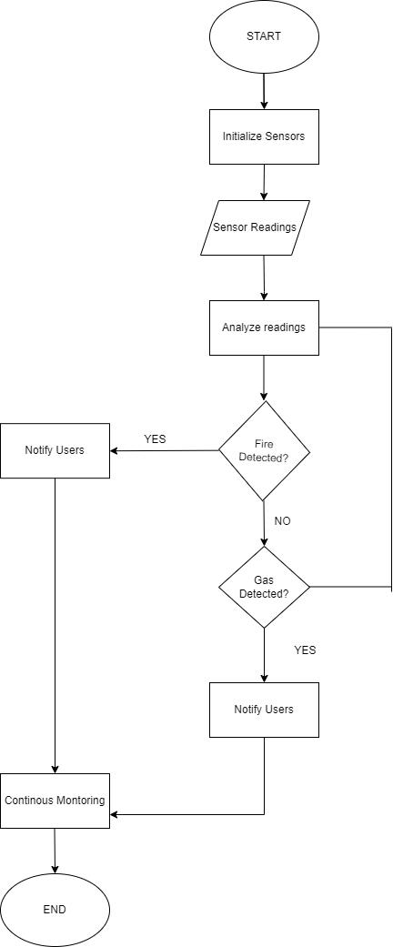
If a flame or gas sensor detects fire or gas leak on the premises, alert the user using the GSM module
08
Fonseka N S W – IT22912770

Slide 9
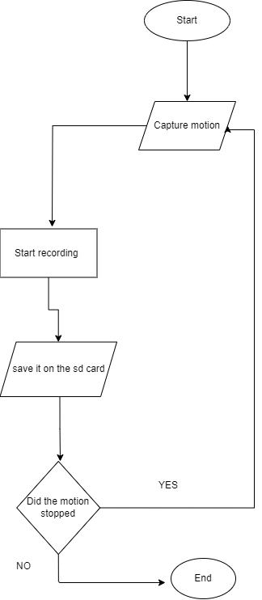
If a PIR sensor detect the intruder (human), capture the photos and short videos using ESP32 WIFI + camera module and store them on the SD card.
User can access real-time images and video streams
09
Bamunuarachchi S S – IT22132000

Slide 10
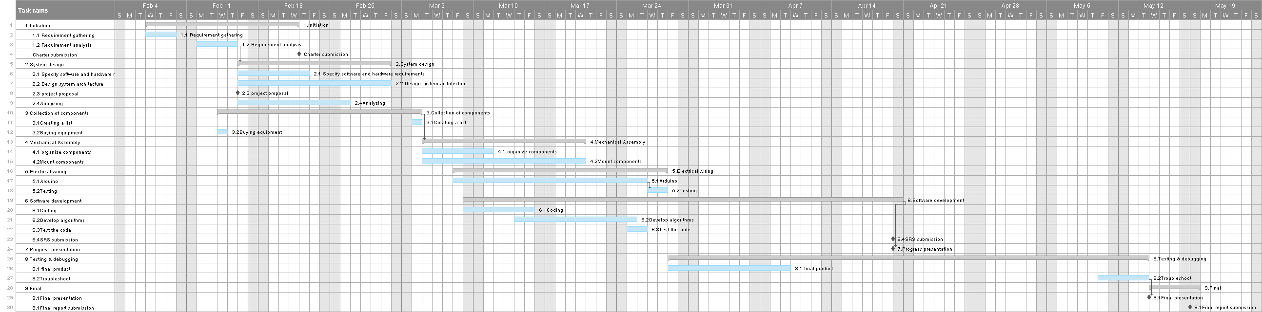
GANTT Chart
10
Bamunuarachchi S S – IT22132000

Slide 11







Hardware and software requirement
Hardware Components
-
Arduino MEGA board
Sensors ( Ultrasonic, IR, PIR, Flame, Gas)
WIFI + camera module
Modules( GSM, SD card, RTC )
Wifi router
Connected device
.
.
N
Software Components
Arduino IDE
Web browser
11
N.W.A.R.S. Karunarathna – IT22069368

Slide 12
Personnel and facilities
Name | Role | Contribution
IT22360250 – Sahan W A G | Project manager Hardware engineer Developer | Movement of the robot. Coding the IR sensor, motor driver and ultrasonic sensor Assembling the robot
IT22069368 – N W A R S Karunarathna | QA engineer Firmware engineer Developer | Capture the motion and send notifications to user. Coding the PIR sensor and GSM module Assembling the code
IT22912770 – Fonseka N S W | Business analyst Documentation specialist Developer | Detect fire and gas threat and send notifications to user. Coding the flame and gas sensor
IT22132000 – Bamunuarachchi S S | Enclosure designer Requirement analyst Developer | Capture videos, photos and save them in storage. Coding the camera module, WIFI module and SD card module.
Resources
Learning Platforms – Coursera, Udemy for online courses in robotics.
Forums and Communities – Reddits’s robotics, and other robotics specific communities
Libraries and Code Repositories – Research Papers, GitHub and GitLab
Books and E- journals
YouTube
12
Fonseka N S W – IT22912770

Slide 13
Budget
ITEM | COST PER UNIT (Rs.) | TOTAL COST (Rs.)
Arduino Mega Board | 5500 | 5500
IR Sensor | 340 | 340
Motor Driver | 200 | 200
IC Base | 15 | 15
Ultrasonic Sensor | 260 | 520
PIR Sensor | 2000 | 2000
GSM Module | 800 | 800
Camera Module | 1500 | 1500
SD Card Module | 250 | 250
Fire Detector | 600 | 600
Gas Sensor | 450 | 450
Robot Chassis | 2000 | 2000
Battery | 3000 | 3000
Jumper Wires and Ties | 575 | 575
Miscellaneous | 1500 | 1500
Total Cost 19250
13
Fonseka N S W – IT22912770

Slide 14

THANK'S FOR WATCHING
IT22360250 – Sahan W A G
IT22069368 – N.W.A.R.S. Karunarathna
IT22132200 – Bamunuarachchi S S
IT22912770 – Fonseka N S W

